Slide 1
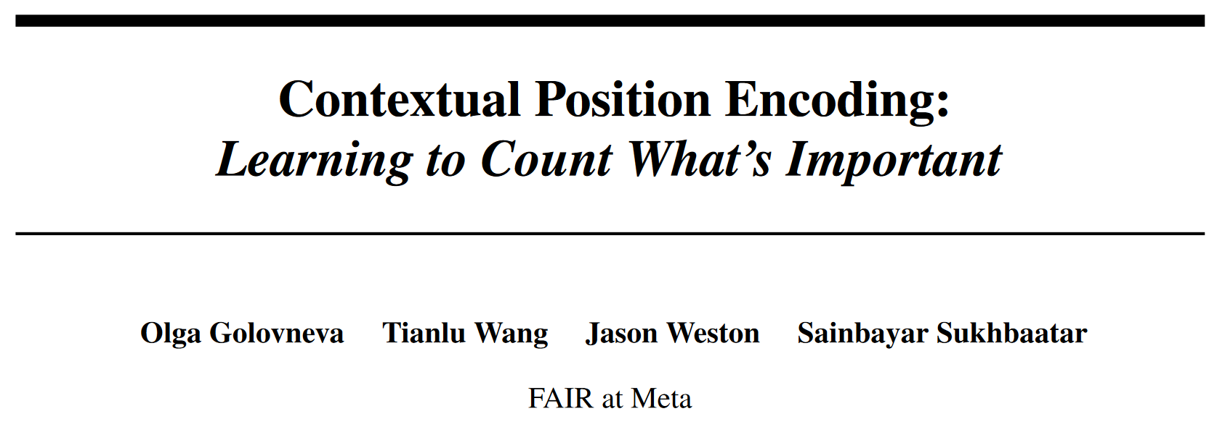
arXiv 2405.18719

Slide 2
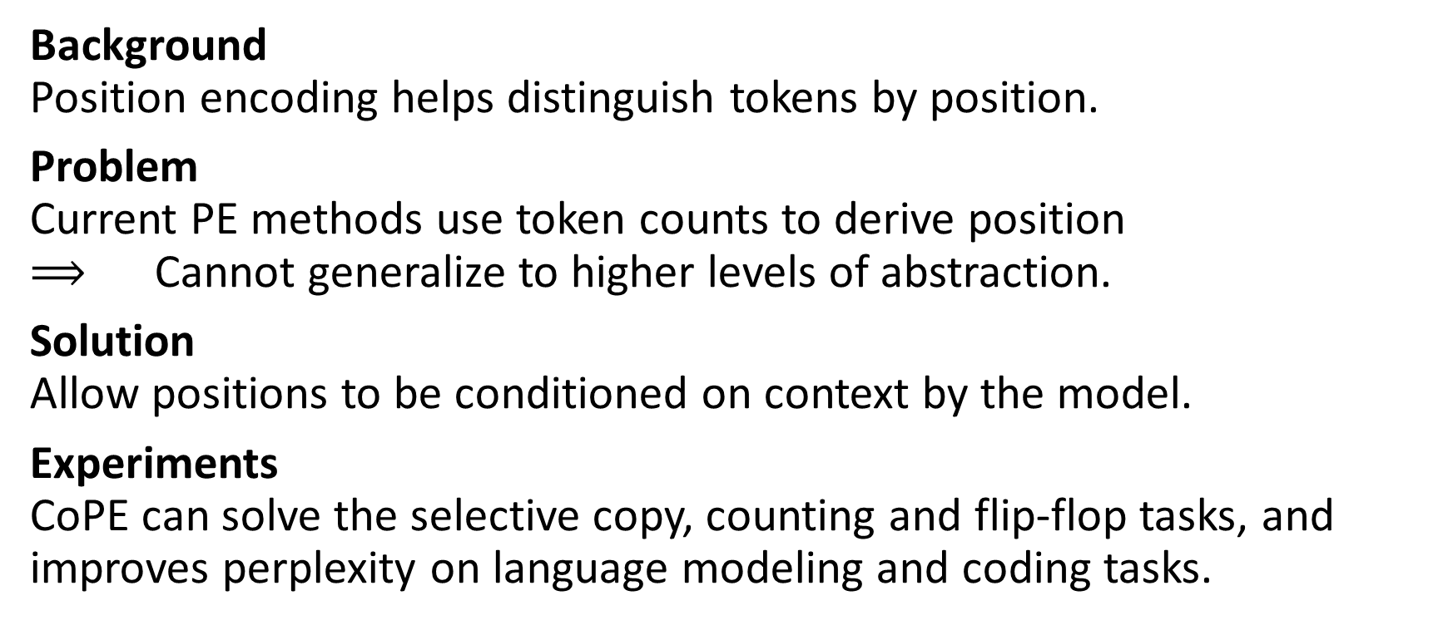
Abstract
Background Position encoding helps distinguish tokens by position.
Problem Current PE methods use token counts to derive position $⟹$ Cannot generalize to higher levels of abstraction.
Solution Allow positions to be conditioned on context by the model.
Experiments CoPE can solve the selective copy, counting and flip-flop tasks, and improves perplexity on language modeling and coding tasks.

Slide 3
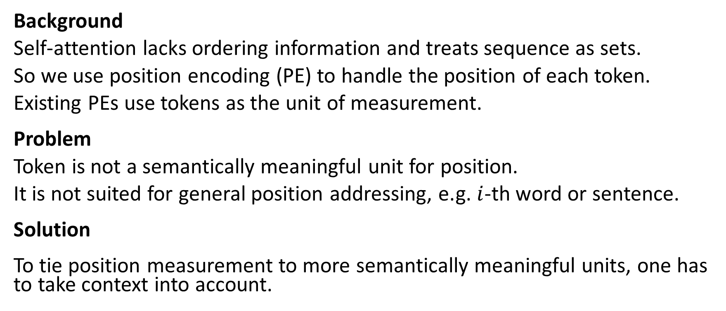
Introduction
Background
Self-attention lacks ordering information and treats sequence as sets.
So we use position encoding (PE) to handle the position of each token.
Existing PEs use tokens as the unit of measurement.
Problem
Token is not a semantically meaningful unit for position.
It is not suited for general position addressing, e.g. $i$-th word or sentence.
Solution
To tie position measurement to more semantically meaningful units, one has to take context into account.

Slide 4
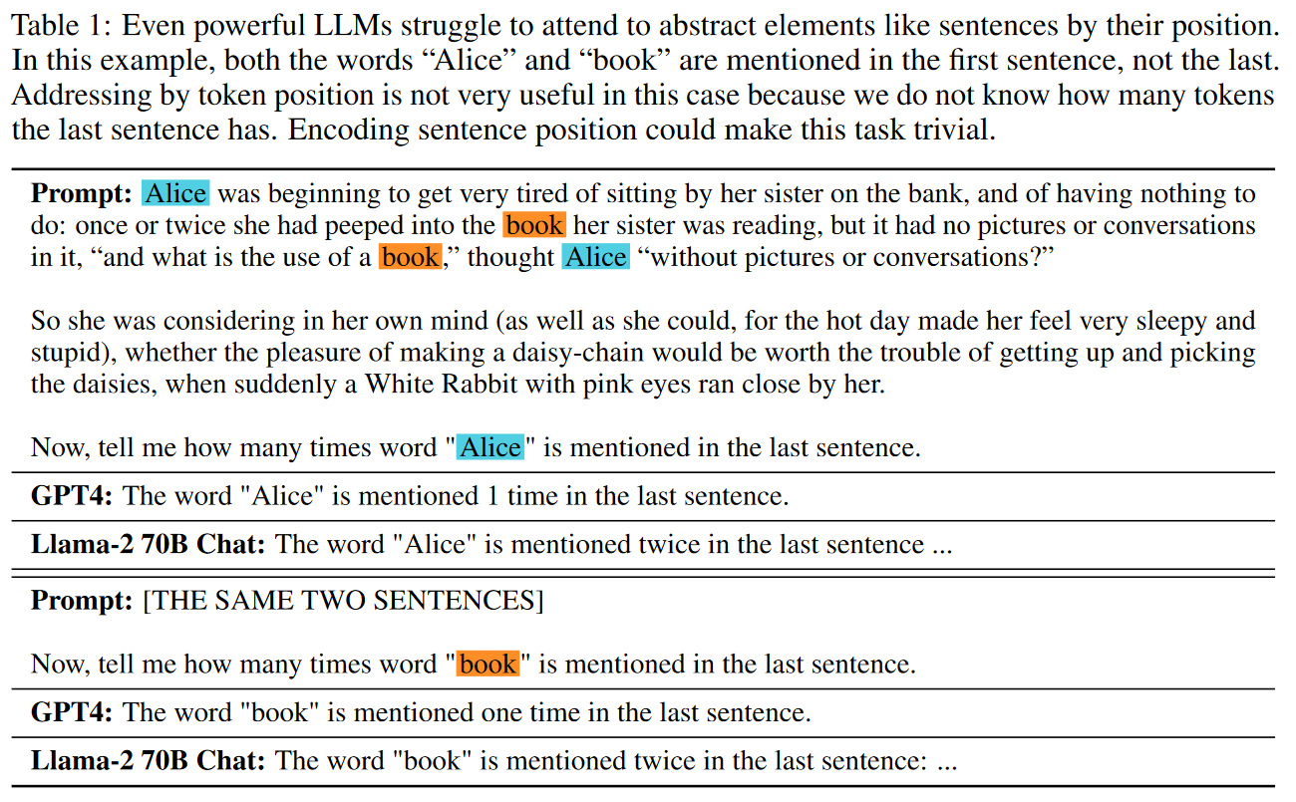
SOTA LLMs fail on counting problems

Slide 5
Standard PE fails on simple toy tasks

Slide 6
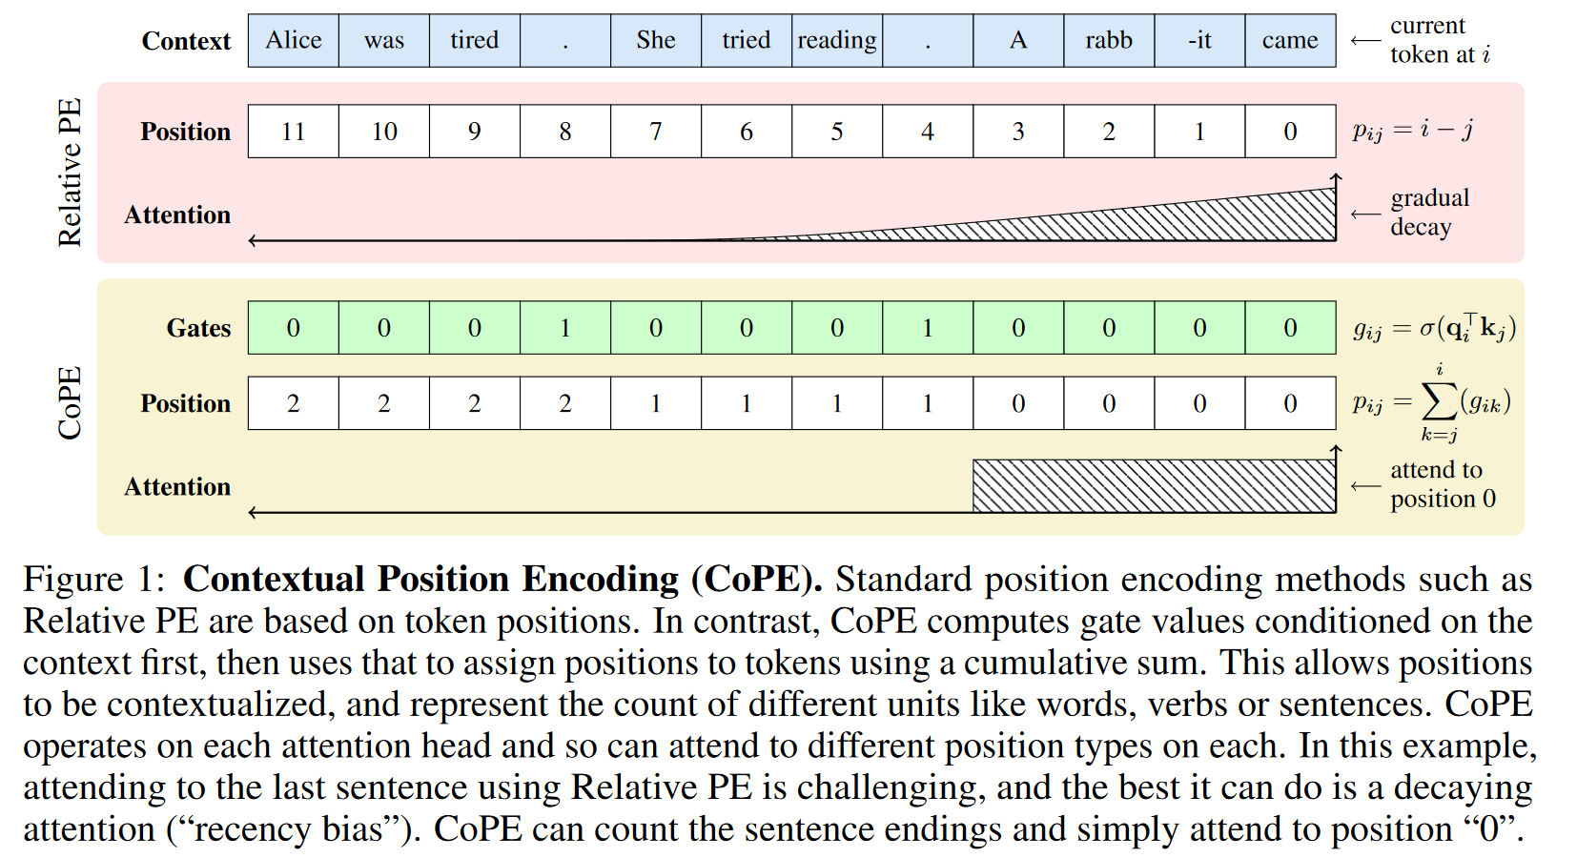
Contextual Position Encoding

Slide 7
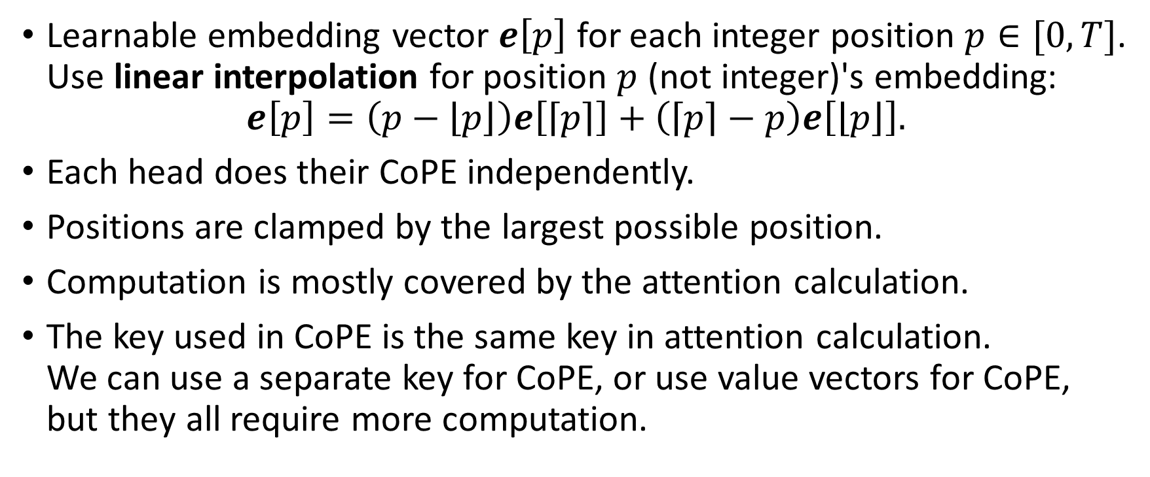
Contextual Position Encoding
Learnable embedding vector $e\left[p\right]$ for each integer position $p∈[0,T]$. Use linear interpolation for position $p$ (not integer)'s embedding:
$$e\left[p\right]=\left(p−\left\lfloor p\right\rfloor \right)e\left[\left\lceil p\right\rceil \right]+\left(\left\lceil p\right\rceil −p\right)e\left[\left\lfloor p\right\rfloor \right].$$
Each head does their CoPE independently.
Positions are clamped by the largest possible position.
Computation is mostly covered by the attention calculation.
The key used in CoPE is the same key in attention calculation. We can use a separate key for CoPE, or use value vectors for CoPE, but they all require more computation.

Slide 8
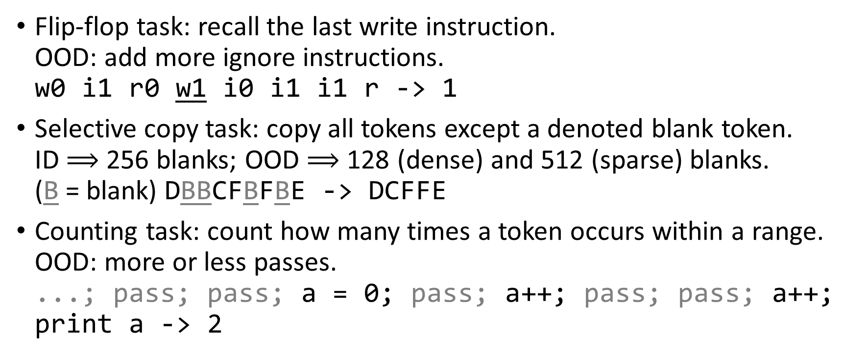
Experiments - Toy tasks
Flip-flop task: recall the last write instruction. OOD: add more ignore instructions. w0 i1 r0 w1 i0 i1 i1 r -> 1
Selective copy task: copy all tokens except a denoted blank token. ID $⟹$ 256 blanks; OOD $⟹$ 128 (dense) and 512 (sparse) blanks. (B = blank) DBBCFBFBE -> DCFFE
Counting task: count how many times a token occurs within a range. OOD: more or less passes. ...; pass; pass; a = 0; pass; a++; pass; pass; a++; print a -> 2

Slide 9
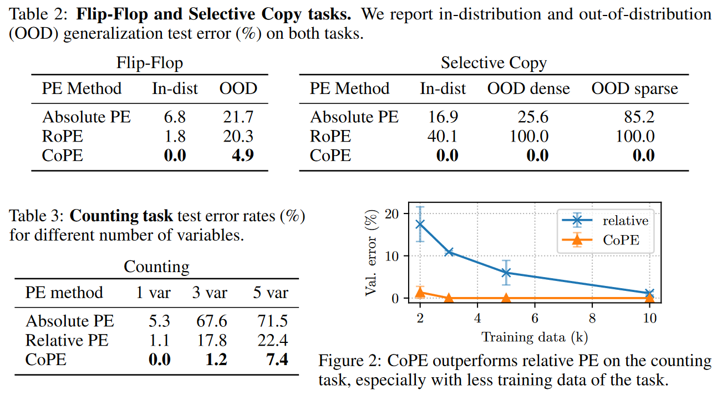
Experiments - Toy tasks

Slide 10
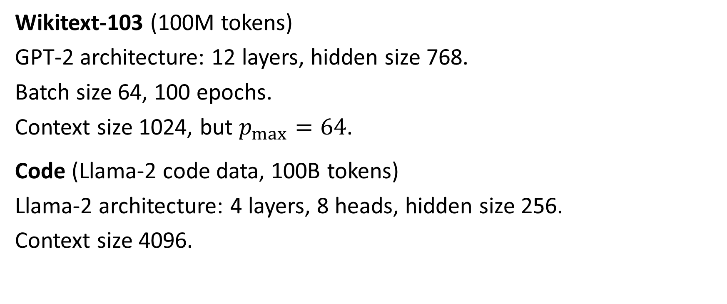
Experiments - Language Modeling
Wikitext-103 (100M tokens)
GPT-2 architecture: 12 layers, hidden size 768.
Batch size 64, 100 epochs.
Context size 1024, but $p_{max}=64$.
Code (Llama-2 code data, 100B tokens)
Llama-2 architecture: 4 layers, 8 heads, hidden size 256.
Context size 4096.

Slide 11
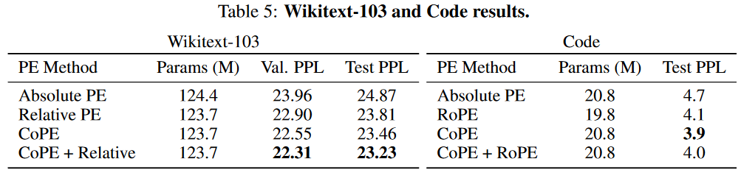
Experiments - Language Modeling

Slide 12
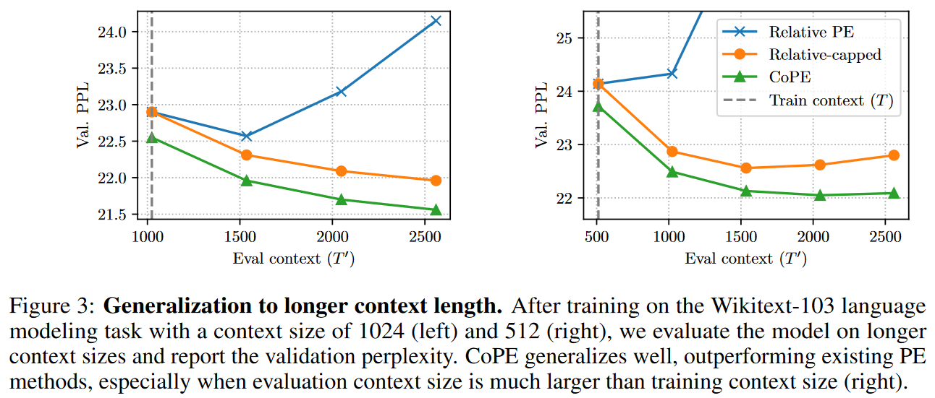
Experiments - Longer context generalization

Slide 13
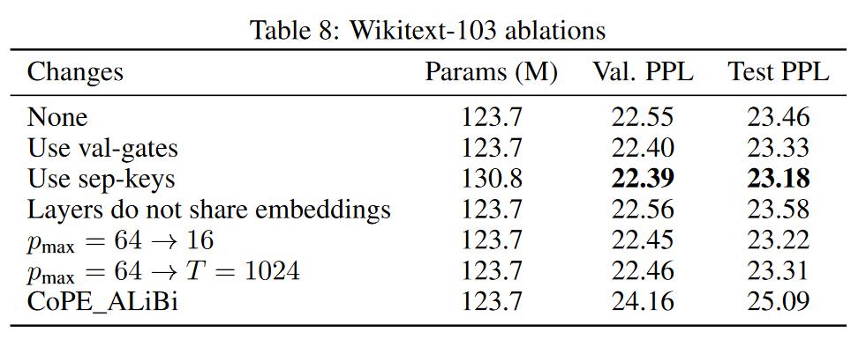
Ablation Study

Slide 14
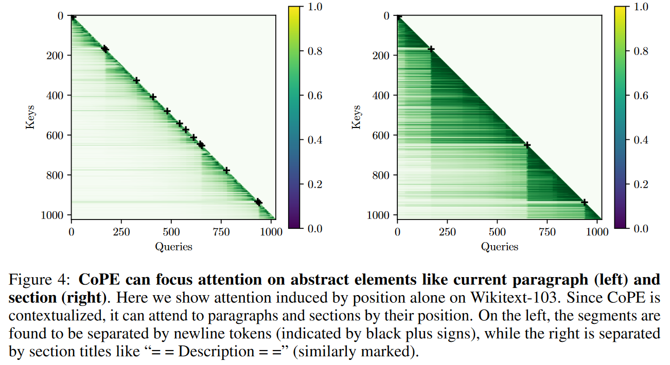
Cases study with separated keys

Slide 15
Ends.

